Slide 1
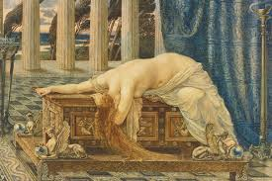
A.I and medical data, Pandora’s box
Did Epimetheus open the AI box? Research, practice and sensitive data

Slide 2
Artificial Intelligence
technology that behaves intelligently autonomously, analyzes and decides and adapts to any changing circumstances

Slide 3
Algorithms, basis of AI
Set of instructions , solving a problem, leading to a certain result.
Currently, many algorithms function like ‘black boxes’. The give answers but no explanations. This is bad news if you are refused a mortgage (‘algorithm says no’) or if the police arrests you (‘algorithm says yes’).
Machine learning, deep learning, self learning

Slide 4
AI and medical data
Medical data refer to all personal data of a physiological character including personal data that can be used for applications for medical use such as personal data that is used for “track and trace” in medical emergency circumstances as for instance epidemic or pandemic or use of data for other public health purposes.

Slide 5
EU Digital health
: Digital health and care refers to tools and services that use information and communication technologies (ICTs) to improve prevention, diagnosis, treatment, monitoring and management of health and lifestyle. Digital health and care has the potential to innovate and improve access to care, quality of care, and to increase the overall efficiency of the health sector.

Slide 6
AI and fundamental rights
Physical integrity
Human autonomy
Privacy and personal data protection
Non discrimination

Slide 7
European Charter Fundamental Rights
Article 1:Human dignity:Human dignity is inviolable. It must be respected and protected.
Article 3 Right to the integrity of the person
1. Everyone has the right to respect for his or her physical and mental integrity.
2. In the fields of medicine and biology, the following must be respected in particular:(a)
the free and informed consent of the person concerned, according to the procedures laid down by law; (d)
the prohibition of the reproductive cloning of human beings.

Slide 8
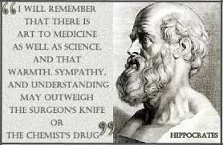
Hippocratic oath
“Whatever I see or hear in the lives of my patients, whether in connection with my professional practice or not, which ought not to be spoken of outside, I will keep secret, as considering all such things to be private.”

Slide 9
Eur. Charter
Article 7 Respect for private and family life
Everyone has the right to respect for his or her private and family life, home and communications.
Article 8 Protection of personal data
1. Everyone has the right to the protection of personal data concerning him or her.
2. Such data must be processed fairly for specified purposes and on the basis of the consent of the person concerned or some other legitimate basis laid down by law. Everyone has the right of access to data which has been collected concerning him or her, and the right to have it rectified.
3. Compliance with these rules shall be subject to control by an independent authority.

Slide 10
Medical data practices
Cognitive Diagnostics: ML to train artificial neural networks to achieve more accurate cancer detectionand classification
EMR: Electronic medical records applications(EMRs) are purported tools for documenting and sharing medical care information.
Chronic Disease Management:processing analyzing and prediction of diabetis, obesitas , MS, heartfailure etc.

Slide 11
Appliances of AI
Robotic: surgery, nano robots, brain implants:.• Machines learning directly from medicaldata could avert clinical errors due to human cognitive biases, positively impacting patient care. Smart solutions to connect (eye) nerves, muscles and tendons. Nano robots bringing medicine to organs, repairing tissue

Slide 12
Other medical apps

Slide 13
Track and trace Apps

Slide 14
article 22 /23GDPR transparancy?
The data subject shall have the right not to be subject to a decision based solely on automated processing, including profiling, which produces legal effects concerning him or her or similarly significantly affects him or her.
Except for explicit consent, contractual obligations, legal obligations and ) is authorised by Union or Member State law to which the controller is subject and which also lays down suitable measures to safeguard the data subject's rights and freedoms and legitimate interests; or

Slide 15
Sensitive Personal data art 9 GDPR
personal data revealing racial or ethnic origin, political opinions, religious or philosophical beliefs, or trade union membership, and the processing of genetic data, biometric data for the purpose of uniquely identifying a natural person, data concerning health or data concerning a natural person's sex life or sexual orientation.

Slide 16
Art 9 Processing sensitive data
A.Explicit consent datasubject
C. necessary to protect the vital interests of the data subject or of another natural person where the data subject is physically or legally incapable of giving consent
G. necessary for reasons of substantial public interest, on the basis of Union or Member State law which shall be proportionate to the aim pursued, respect the essence of the right to data protection and provide for suitable and specific measures to safeguard the fundamental rights and the interests of the data subject;
i. (i) processing is necessary for reasons of public interest in the area of public health, such as protecting against serious cross-border threats to health or ensuring high standards of quality and safety of health care and of medicinal products or medical devices, on the basis of Union or Member State law which provides for suitable and specific measures to safeguard the rights and freedoms of the data subject, in particular professional secrecy

Slide 17
Info obligation GDPR, sensitive data
recital39 stipulates, amongst other things, that data subjects should be “made aware of the risks, rules, safeguards and rights in relation to the processing of personal data and how to exercise their rights in relation to such processing”.

Slide 18
Informing data subjects EDPB
Recital 60 also refers to the requirement that the data subject be informed of the existence of the processing operation and its purposes in the context of the principles of fair and transparent processing. For all of these reasons, WP29’s position is that, wherever possible, data controllers should, in accordance with the principle of fairness, provide the information to data subjects well in advance of the stipulated time limits

Slide 19
Janus head article 9
4. Member States may maintain or introduce further conditions, including limitations, with regard to the processing of genetic data, biometric data or data concerning health.

Slide 20
European Group on Ethics in Science and New Technologies Ethical principles and democratic prerequisites
Human dignity
Autonomy :of humans
Responsibility : AI research and application to align with a plurality of fundamental human values and rights
Justice, equity, and solidarity: non discriminatory equal access to ‘autonomous’ technologies and fair distribution of benefits and equal opportunities across and within societies
Democracy:publicaly informed key decisions on the regulation of AI development
Rule of law and accountability: unbiased access to justice and the right to redress and a fair trial
Security, safety, bodily and mental integrity

Slide 21
Use of AI
Research: guarantees on informing the public , transparancy?
Sharing and analyzing medical records? Informing subject, consent, anonymizing?
Robotics and smart appliances? Controling use, security?

Slide 22
Risks
The telemetry data is encrypted ? ( Un)controllable by the user to servers of various tech giants
secure storing? Where , why?
hacking of data not impossible
(blue tooth) connections and transport facilities trustworthy
reverse engineering possible
sense of security and privacy: conspiracy
access to data and information? Not secured
Actions based on (uncontrolable) medicalemergency law

Slide 23
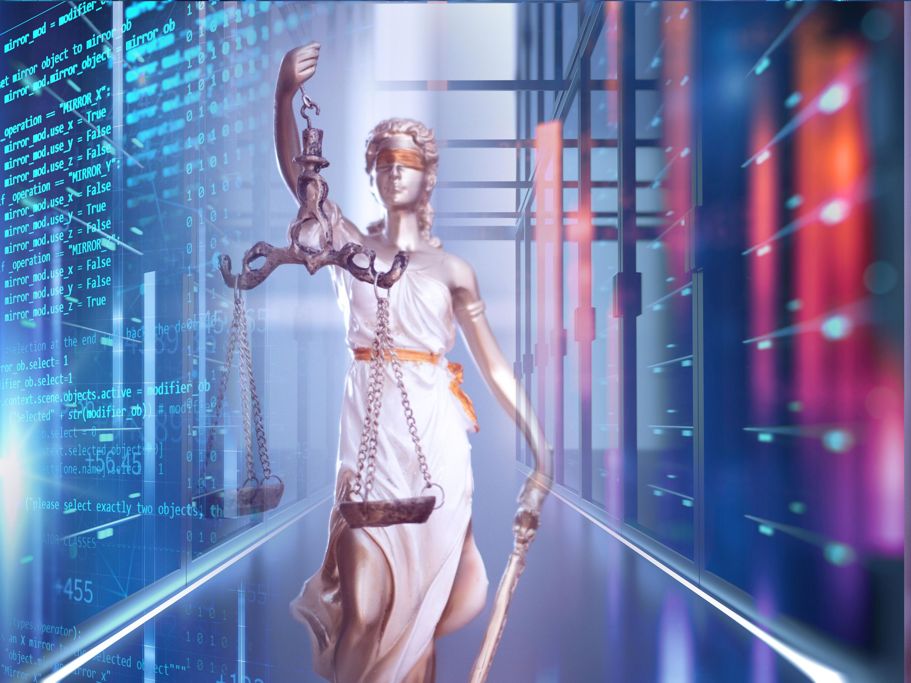
Thank you for your attention

