Slide 1
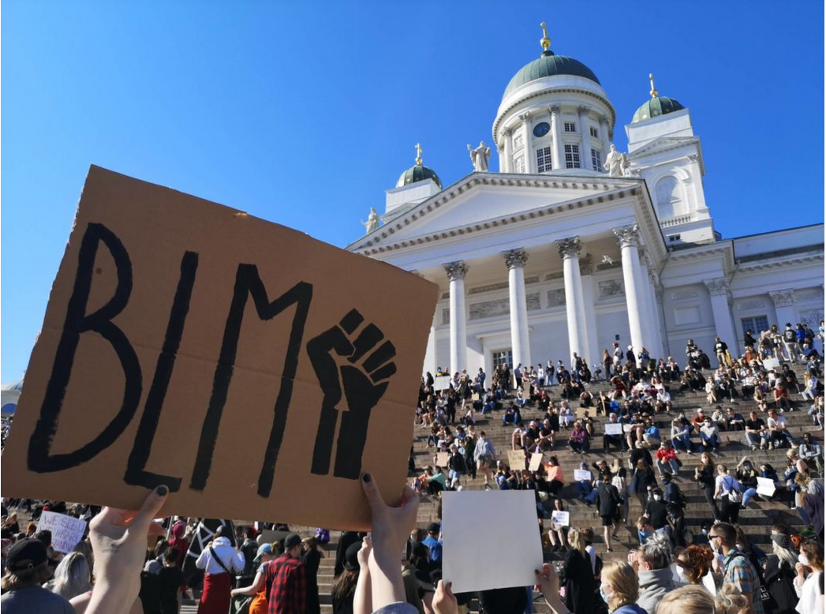
“It goes somewhere particularly painful”
– Social workers’ orientations towards whiteness and racialised structures in the Finnish professional context
26.5.2023
International Summer School:
Social Work and Social Science from a Global Perspective
Enni Mikkonen, Dr. Soc.Sci
University Researcher
Faculty of Social Sciences / Social Work
University of Lapland
valtioneuvosto.fi

Slide 2
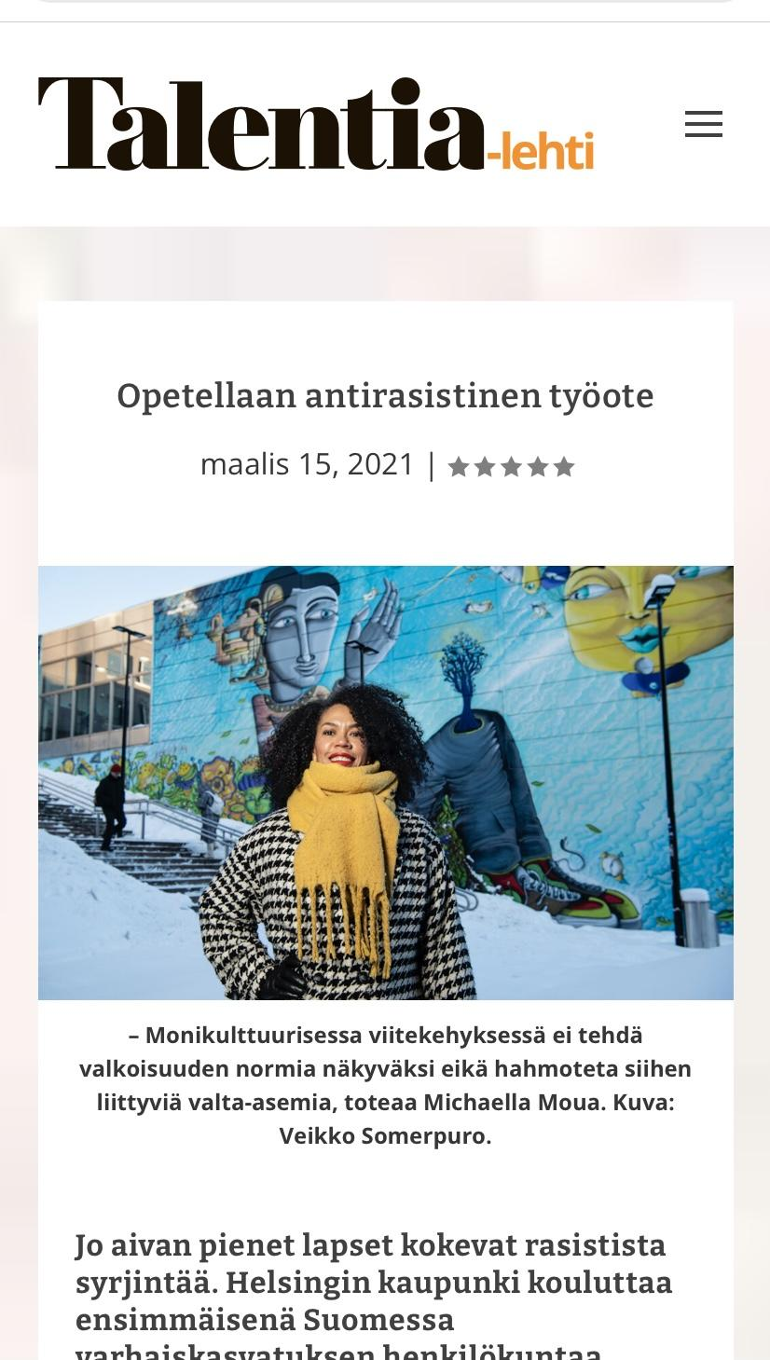
Why should we talk about whiteness?
Isn’t social work inevitably
an anti-racist profession?
Talentia-lehti

Slide 3
At the intersection of
whiteness, racialisation and colonisation
whiteness
intersectionality
colonisation
racialisation

Slide 4
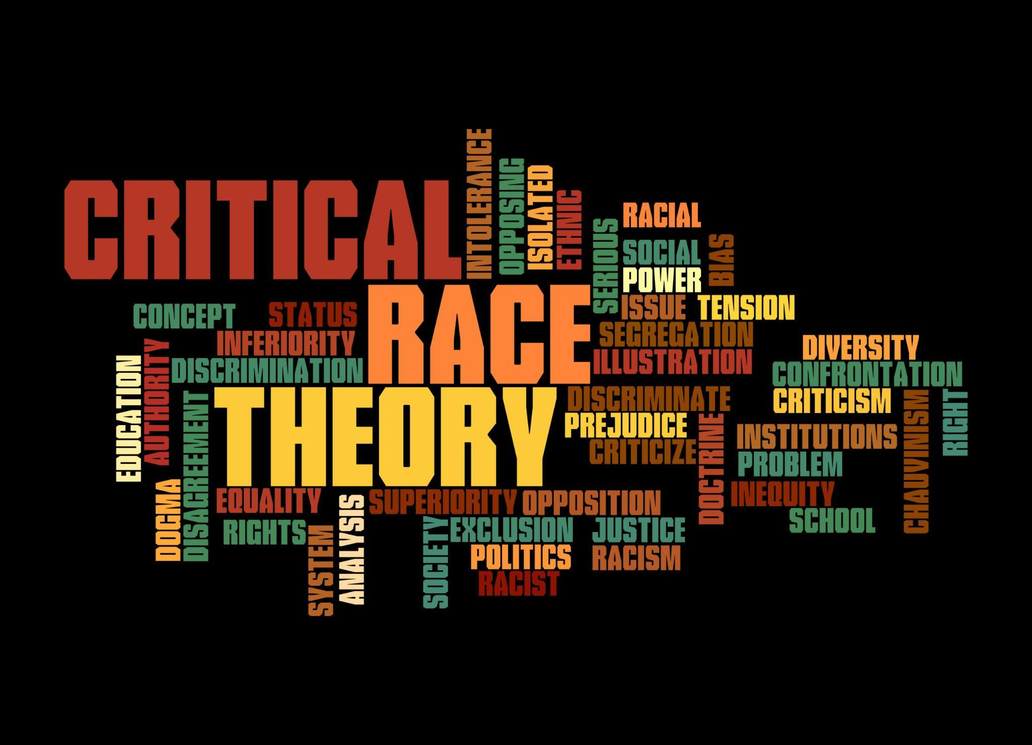
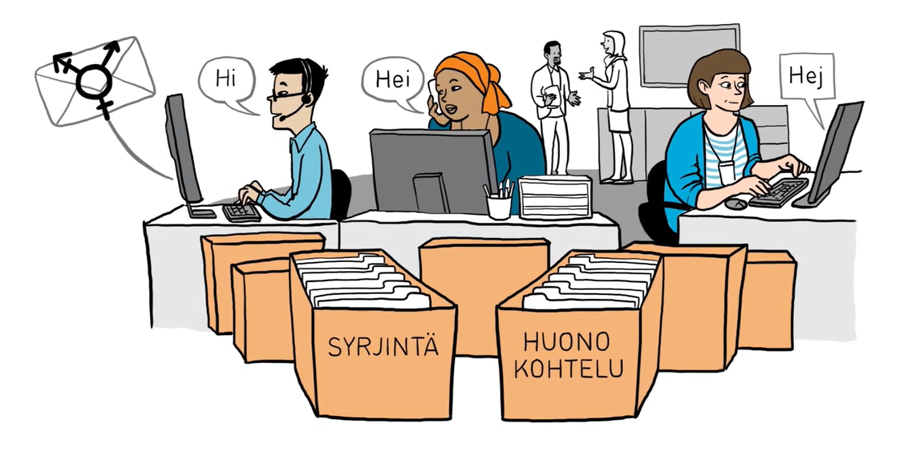
’Race’
@Adobe Stock
Racialisation
Concept
@Equinoxrji
Process
Racism
E.g. Keskinen 2021, Hubara 2020
System
Yhdenvertaisuusvaltuutettu (syrjinta.fi)

Slide 5
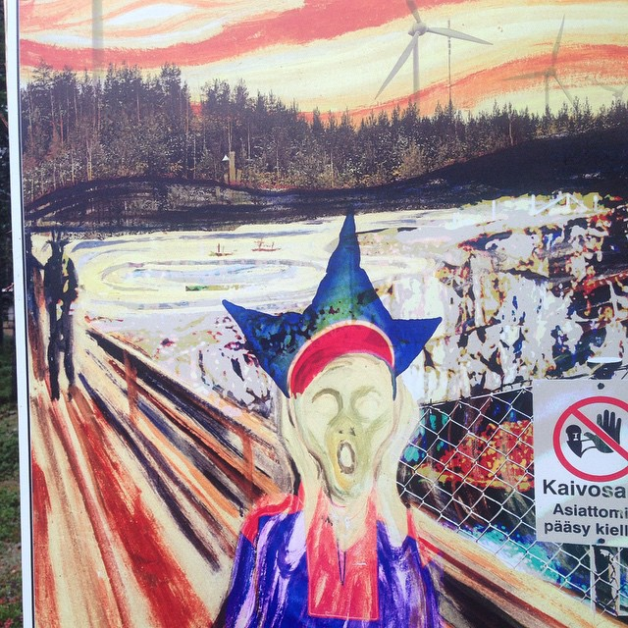
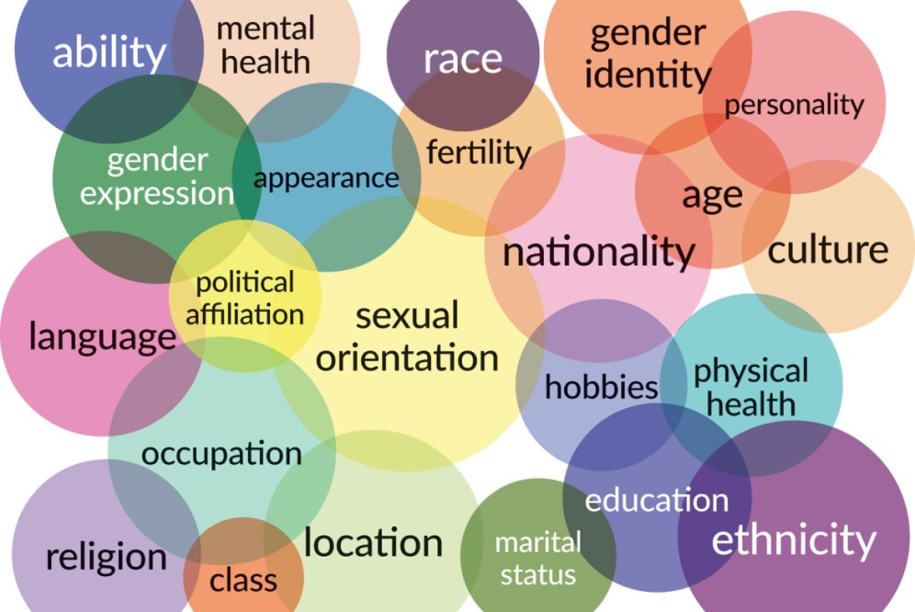
Coloniality
Intersectionality
Colonial participation
Intersecting social categories and identities
@ Misty McPhetridge, BSSW

Slide 6
Whiteness
Critical whiteness studies:
Whiteness as a central feature of racialisation (e.g. Ahmed 2004)
Built on “a set of locations that are historically, socially, politically and culturally produced” (Lee & Bhuyan, 2013, 99)
Not a monolithic experience – who is defined as white?
Normative whiteness
White ”innocence” and silence
White privilege and supremacy
White savior
→ Studying whiteness comes with risks of recentralising whiteness and sustaining the power structures – the importance of an antiracist analysis (Keskinen 2021)

Slide 7
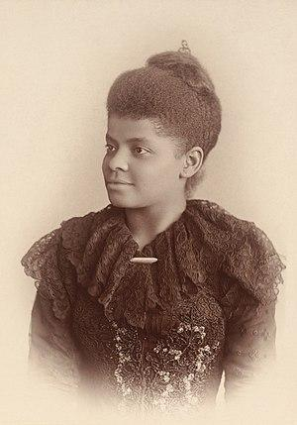
”Shadow” of whiteness and colonial continuums in international social work
Ida B. Wells and other black pioneers who have impacted social work professional dvelopment
(Aguilar & Counselman-Carpenter 2021)
Examining the history of social work shows how white normativity and coloniality have built the hegemonic knowledge base and practice in the field
@Mary Garrity
‘Development’
-framework, the ’civilising’ mission of international social work in the Global South and among the Indigenous Peoples (Dominelli 2010)

Slide 8
”Shadow” of whiteness and colonial continuums in social work in Finland
Culturally sensitive working orientation
→ relies on the critical reflection of one's own unconscious biases and thereby it can increase sensitivity to differences
(Heino & Jäppinen 2022)
→ the problem of culturalisation (Jönsson 2013)
Universalism as the basis for the social services
→ the interpretation of universalism is critisised for being based on national unity and a white narrative
→ issues of unequality are linked mostly to the questions of class and gender, unacknowledging structural racism
(Riitaoja et al. 2021, 268)

Slide 9
Qualitative study on social workers’ perspectives
How do social workers orientate themselves towards normative whiteness as a part of the social service system and in their practice encounters?
How do the meanings, encounters and processes involved in the structures and practices of social work produce, maintain and/or dismantle normative whiteness and racialising structures?
Open interviews of 12 social workers from different regions and positions in Finland:
Child protection, immigration services (integration services, reception center and services for undocumented immigrants), hospital
Practice, management, expert tasks in the development of social and health services, research

Slide 10
Results: Producing, sustaining and deconstructing white normativity in social work
Savior orientation | System-centered – (järjestelmäkeskeinen) orientation | Solidarity orientation
Victimisation | Sublety (hienojakoisuus) | Intersectionality
Controlling | Silence | Global responsibility
Bundling (niputtaminen) | Powerlessness | Partnership and activism

Slide 11
Savior orientation
Victimisation Victimised position in the service system Saving from the cultural ”deficiencies” Genderisation | Controlling Maintaining borders Suspicion ”Hatches” (”luukut”) | Bundling (niputtaminen) Stereotyping and generalisation Defining and resolving problems on behalf of others
-- In my opinion, there you can very strongly notice that kind of white savior who will be like ‘these clients do not understand’ or ‘do not know’ or they cannot trust them and that ‘now we have to do something on behalf of them’. In a way, they are made dependent on that system to the point that they are forced into such a victim position, from which it is hard to get out --
Social worker 3

Slide 12
System-centered orientation (järjestelmäkeskeisyys)
Subtlety (hienojakoisuus) Internalised norms Hegemony in institutions | Silence ”Painful matter” Difficulty to perceive (hahmottaa) | Powerlessness No means to act upon situations (structures) Worrying about the consequences
It’s weird, because if, let's say, I had insufficient knowledge on a completely different topic and someone pointed it out to me, I wouldn’t mind at all. -- But racism or topics related to discrimination, prejudices, correcting them, it sounds like poking me. Maybe it goes somewhere particularly painful for us social workers if it is pointed out that you treat someone unfairly.
Social worker 6

Slide 13
Solidarity orientation
Intersectionality Individual differences Intersecting social categories | Global responsibility Structural framework One’s own role in the global network | Parntership and activism Participatory working orientation Reflectivity-analyticality Advocating against injustices in cooperation
--- or yes, I had this kind of systemic criticism before, but especially when it was somehow so extreme there in the reception center; the presence of the ‘asylum machinery’. It was still at that time. It was 2016 year. Somehow I got more of a similar fighting mode against the Finnish state, or a little like through solidarity - not so much that we save those others, but somehow that we fight together with them.
Social worker 10

Slide 14
-- I think it would be more important than talking about who is racist and who isn't, so to talk about racism as a phenomenon and as a structural thing that affects us all, because we are brought up and operate in a society with racist structures. Maybe it's hard to get into that conversation, because easily everyone has a pretty strong need to somehow justify why racism doesn’t concern them. It is something that lies outside of them in some other people, some who are less educated or hold a different political opinion or in any case others.
Social worker 4

Slide 15
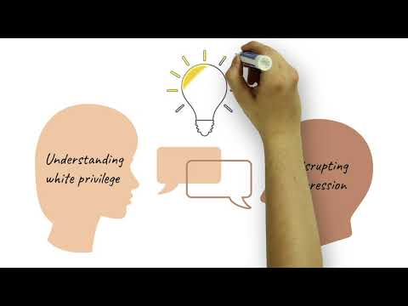

Slide 16
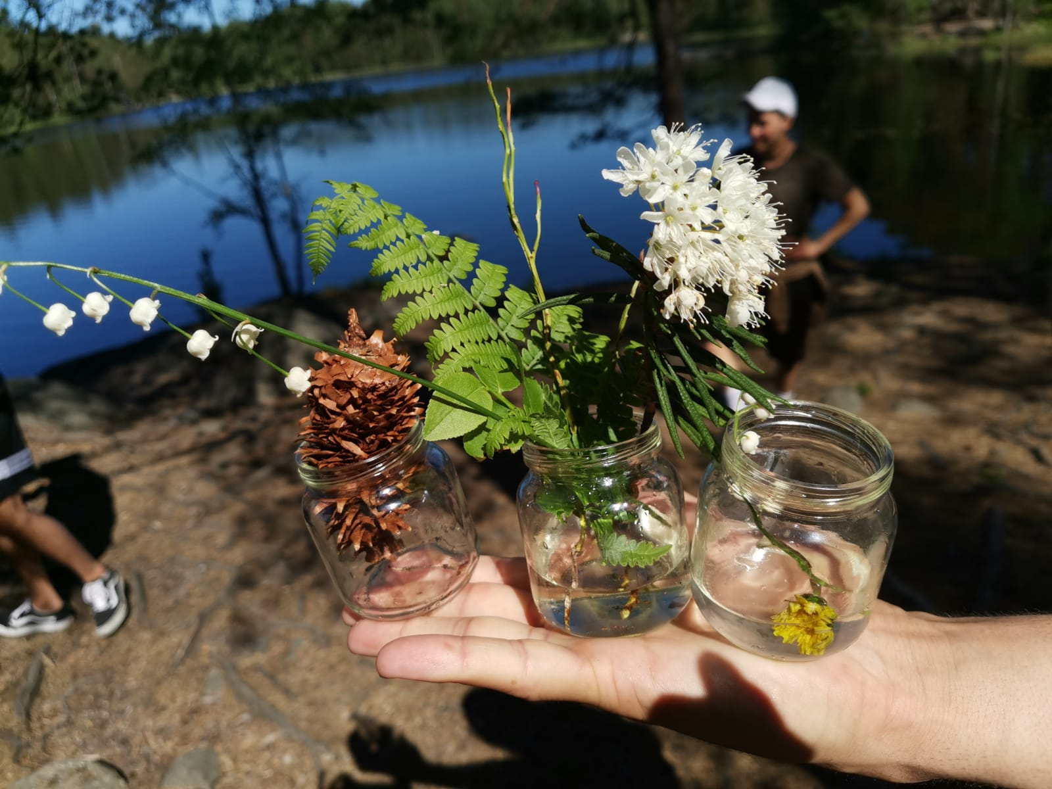
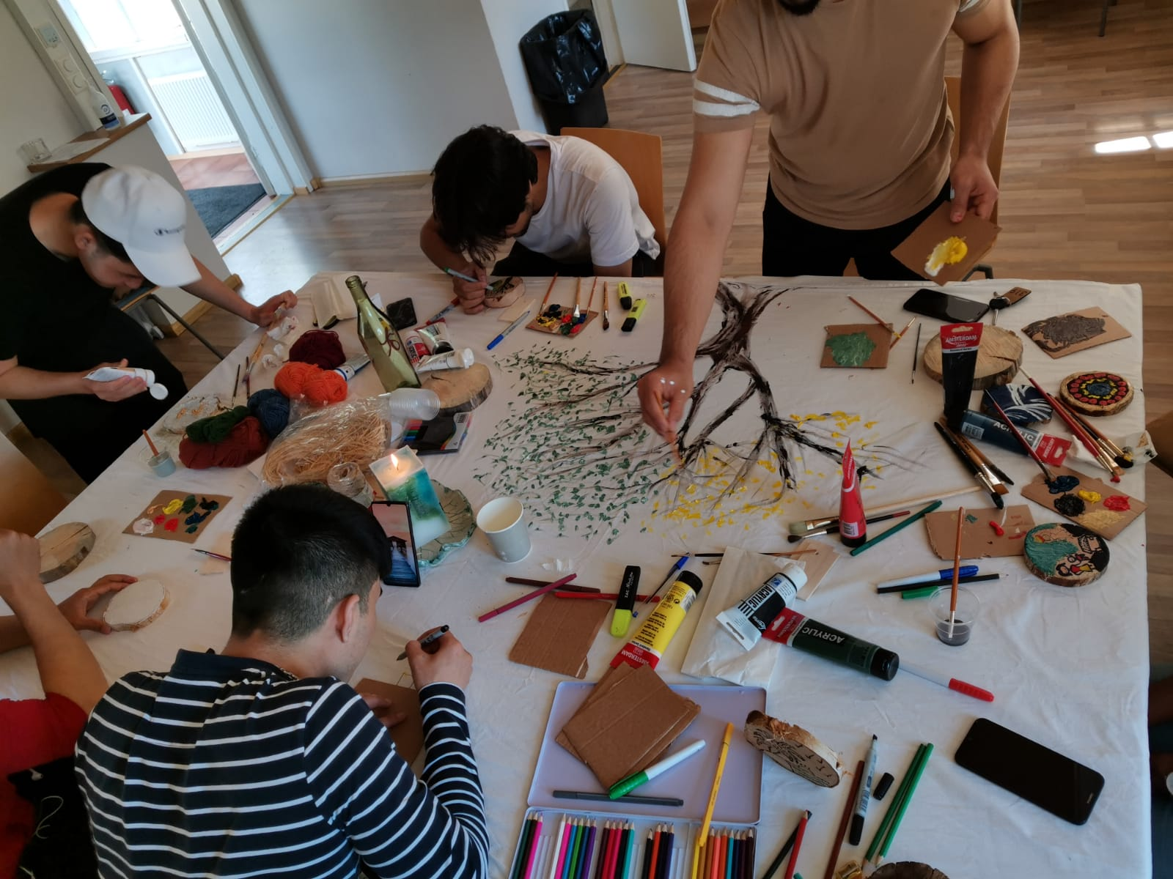
Kiitos, thank you!
enni.mikkonen@ulapland.fi

Slide 17
References:
Aguilar, Jemel & Counselman-Carpenter, Elisabeth (2021) ‘The Mirage of Action’: Exploring the Social Work Professions’ Perpetuation of White Supremacy Through ‘Well-Intentioned’ Actions. Advances in Social Work (21) 2/3, 1020–1044.
Ahmed, Sara (2007) A Phenomenology of Whiteness. Feminist Theory 8 (2), 149–168.
Dominelli, Lena (2010) Social Work in a Globalizing World. Polity Press, Cambridge/Malden.
Heino, Eveliina & Jäppinen, Maija (2022) Näkökulmia kulttuurin merkityksiin sosiaalityön käytännöissä ja tutkimuksessa. Janus 30 (2), 174–181.
Hubara, Koko (2020) Helsingin yliopiston sosiaalityön opetus kriittisen rotuteorian näkökulmasta: Teemoitteleva sisällönanalyysi. Pro Gradu -työ, Helsingin yliopisto, Helsinki, http://urn.fi/URN:NBN:fi:hulib-202012285601 Luettu 22.3.2022.
Jönsson, Jessica (2013) Social work beyond cultural otherisation. Nordic Social Work Research 3(2), 159–167.
Keskinen, Suvi & Mkwesha, Faith & Seikkula, Minna (2021) Teoreettisen keskustelun avaimet – Rasismi, valkoisuus ja koloniaalisuuden purkaminen. Teoksessa Suvi Keskinen, Minna Seikkula & Faith Mkwesha (toim.), Rasismi, valta ja vastarinta: Rodullistaminen, valkoisuus ja koloniaalisuus Suomessa. Helsinki: Gaudeamus, 69–84.
Lee, Eunjung & Bhuyan, Rupaleem (2013) Negotiating within Whiteness in Cross-Cultural Clinical Encounters. Social Service Review 87 (1), 98–130.
Riitaoja, Anna-Leena & Jäppinen, Maija & Kara, Hanna & Nordberg, Camilla (2021) Siirtolaisuus ja moninaisuus sosiaalityön yliopistokoulutuksen ja sosionomi (amk)-koulutuksen opetussuunnitelmissa. Janus 29 (3), 267–285.
Smith, Linda Tuhiwai, Tuck, Eve & Yang, K. Wayne (2019) Introduction. In T. S. Smith, E. Tuck, & K. W. Yang (Eds.), Indigenous and decolonizing studies in education. Mapping the long view. New York: Routledge.
Young, Susan (2011) Social Work Theory and Practice: the Invisibility of Whiteness. In Moreton-Robinson, A (ed.): Whitening Race: Essays in Social and Cultural Criticism. Cranberra: Aboriginal Studies Press, pp. 104–118.

