Slide 2
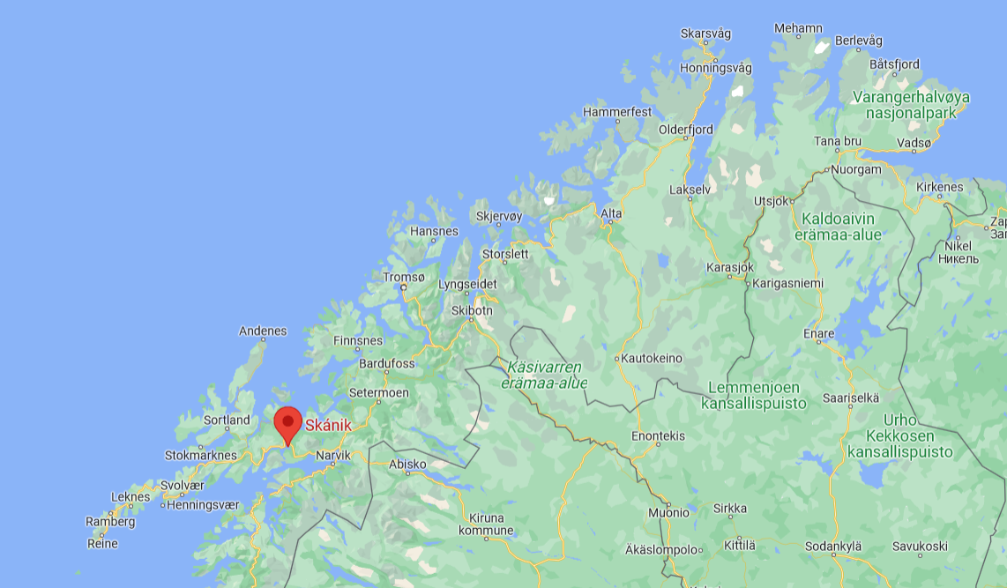
Mu birra / About me
Brede Eder Murberg
SSDN:a jođiheaddji Boardleader of SSDN
Bajásšaddan Lulli-Norggas, gullevašvuohta Skániide Grown up in southern Norway, roots in Skánik
Lean lohkan informatihka, dál logan davvisámegiela Studied computer science, currently studying Northern Sámi

Slide 3
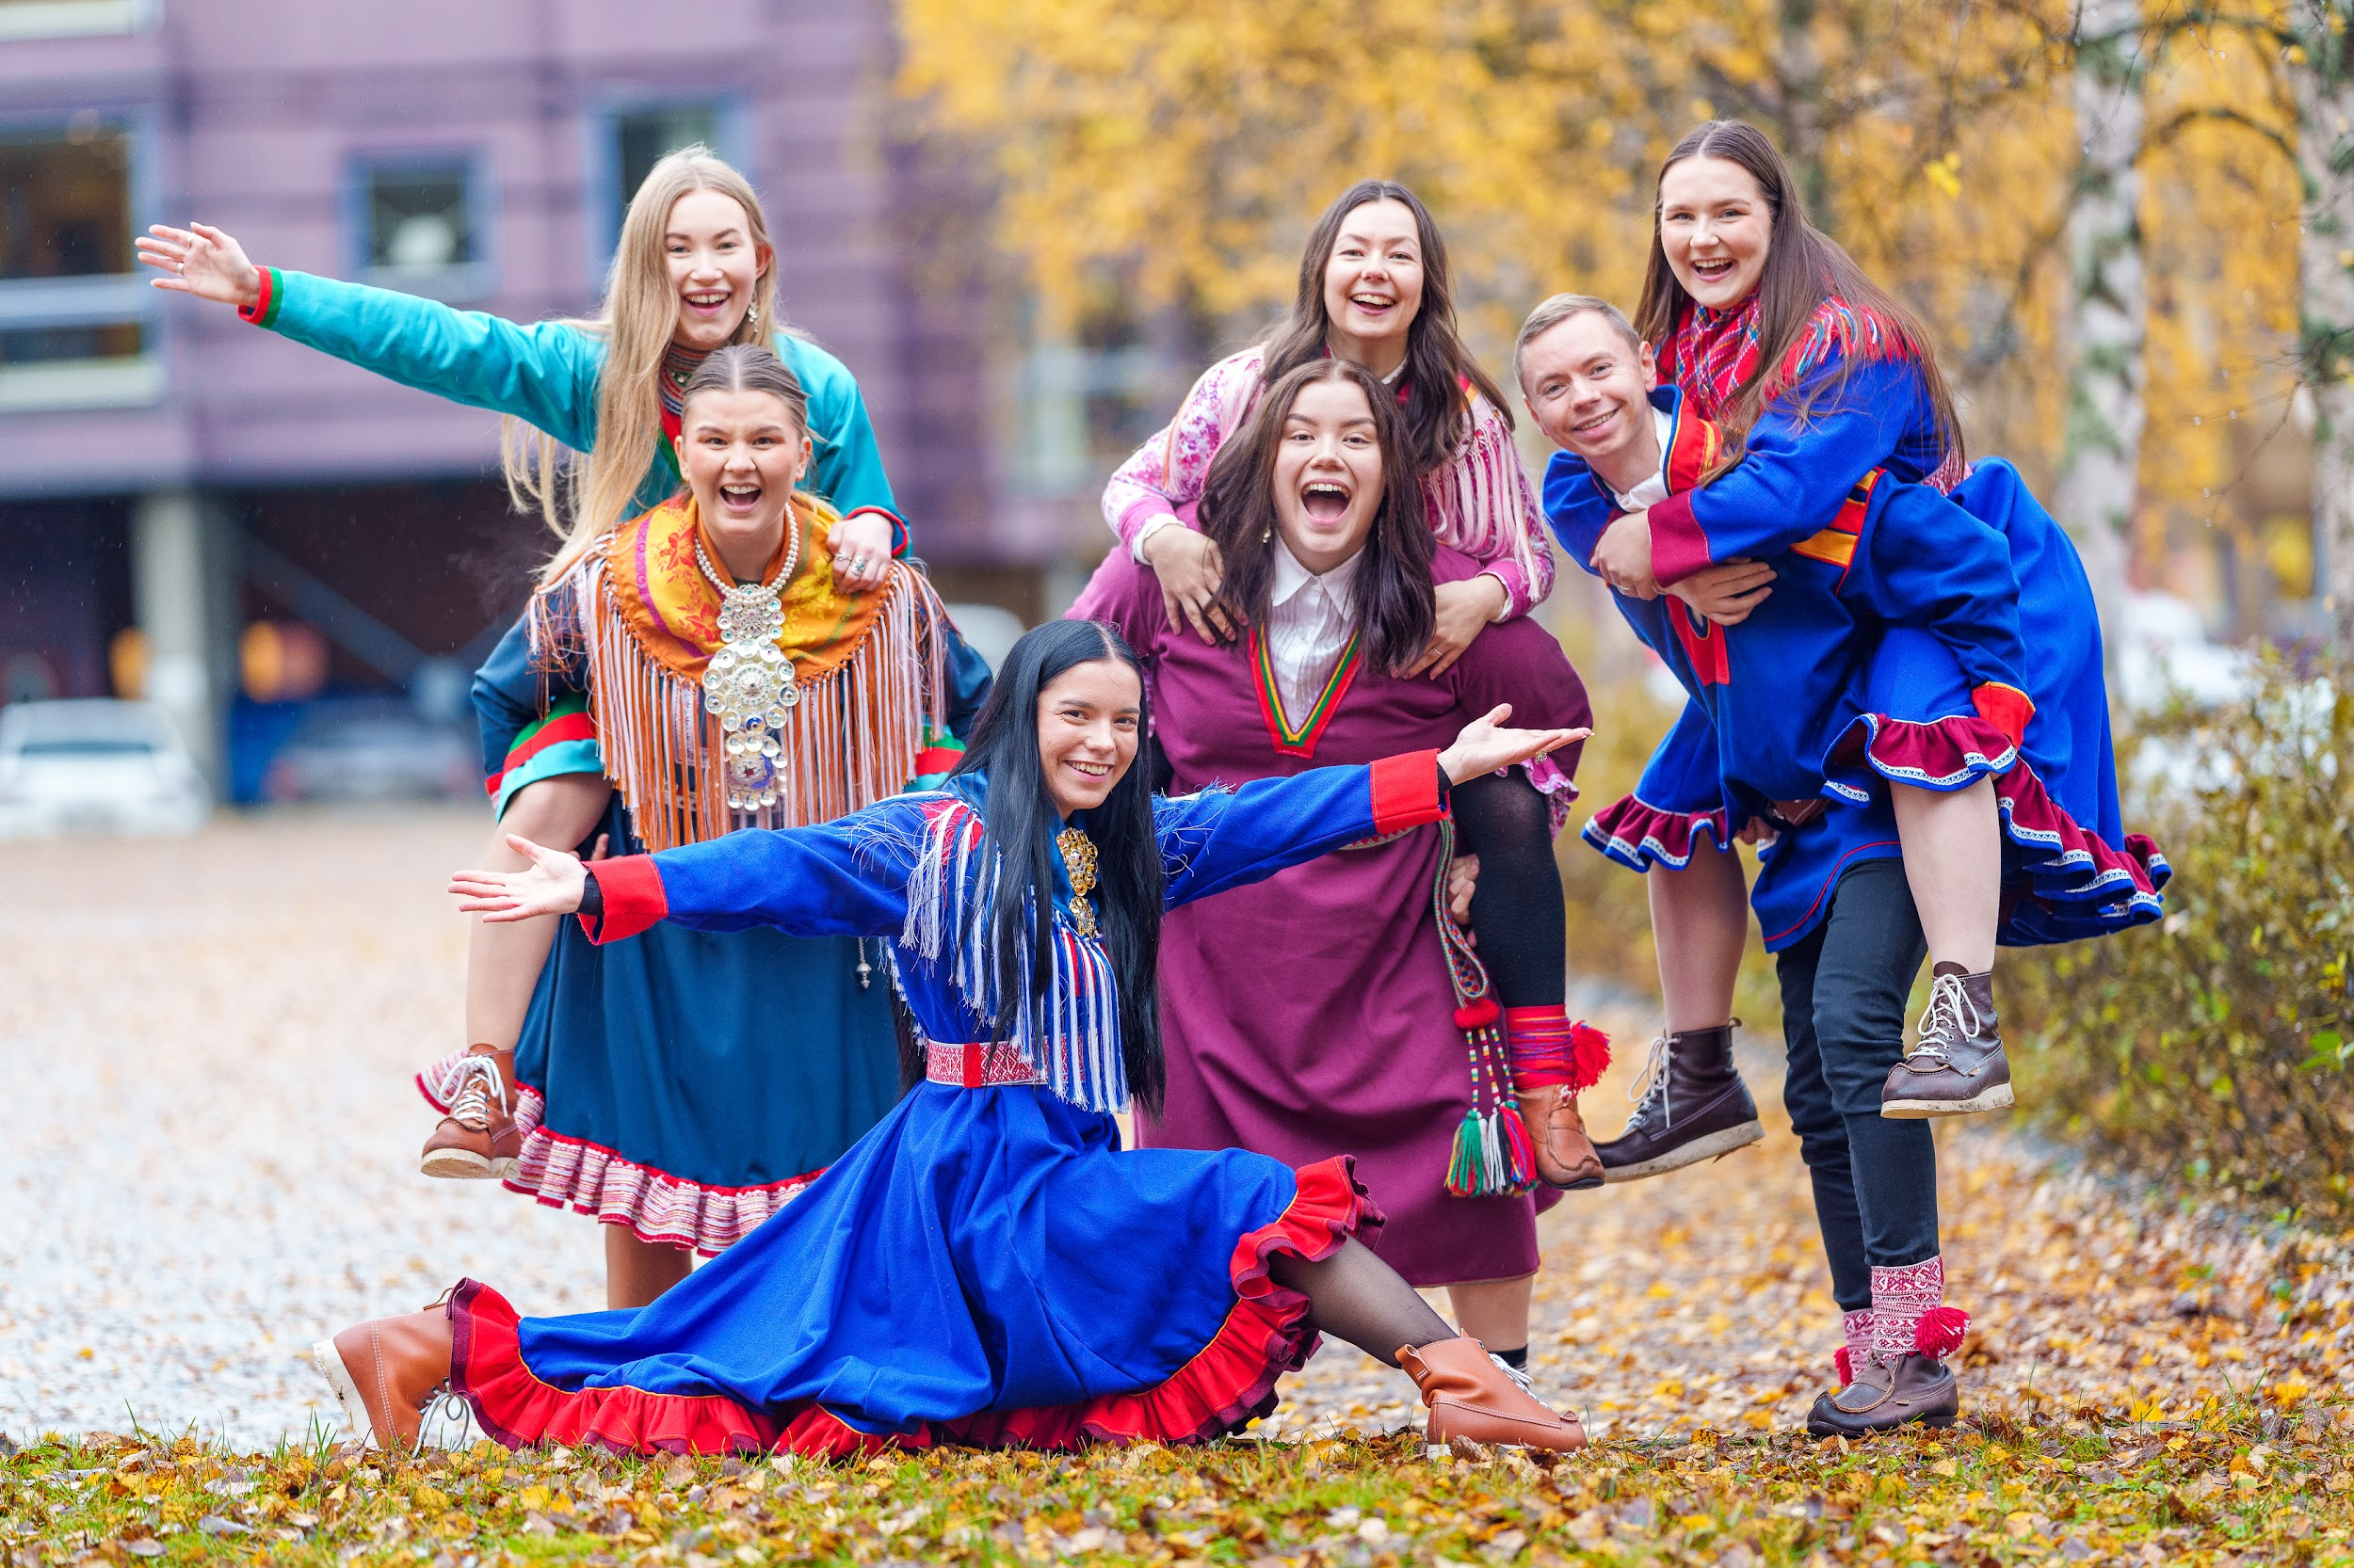
Mii lea SSDN? / What is SSDN?
Studeantasearvi sámi studeanttaide UiT:s Student organization for sámi students at UiT
Mii láigidt somás doaluid gos sámi studeanttat sáhtet deaivvadit ja ovttastallat nubbi nuppiin We organize events where sámi students can meet and hang out with each other
Mii loktet sámi studeanttaid áššiid ja oainnuid UiT:a administrašuvdnii We raise sámi students issues and views to UiTs administration
Sulli 70 miellahtu Around 70 members

Slide 4
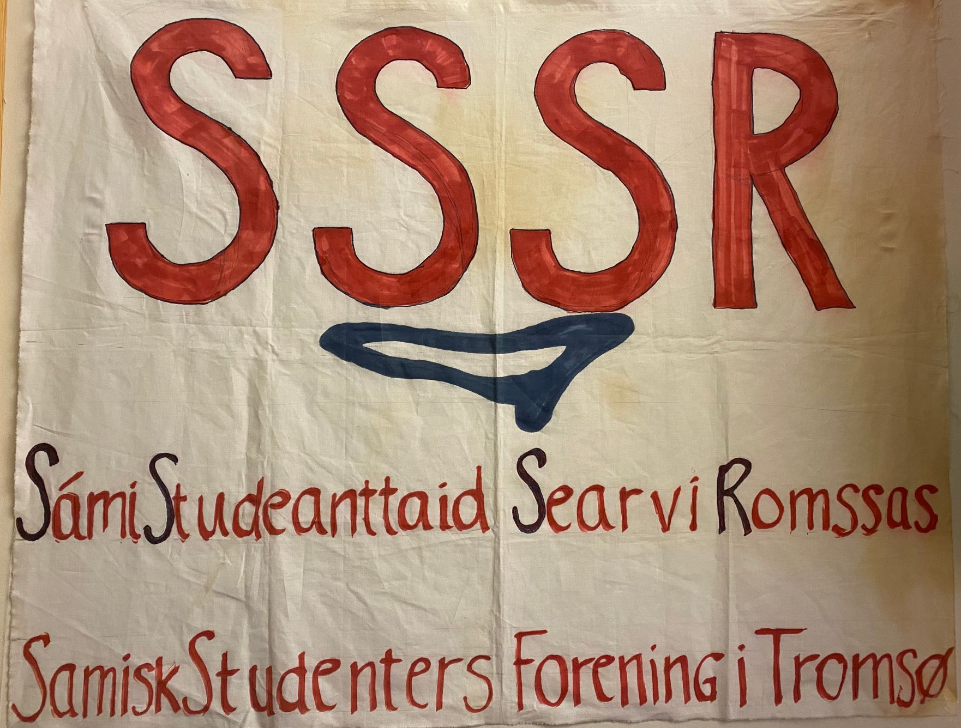
Min historjá / Our history
1983:s vuođđoduvvui (42 jagi) Founded in 1983 (42 years)
Akta dain boarraseamos sámi nuoraidsearvviin mii ain doaimmahuvvo One of the oldest sámi youth organizations that are still active
Dálle leimmet Sámi Studeanttaid Searvi Romssas (SSSR) Started as SSSR
2016:s rievdadeimmet nama ja šattaimet Sámi Studeantasearvi Davvi-Norggas (SSDN) In 2016 we changed our name to SSDN

Slide 5
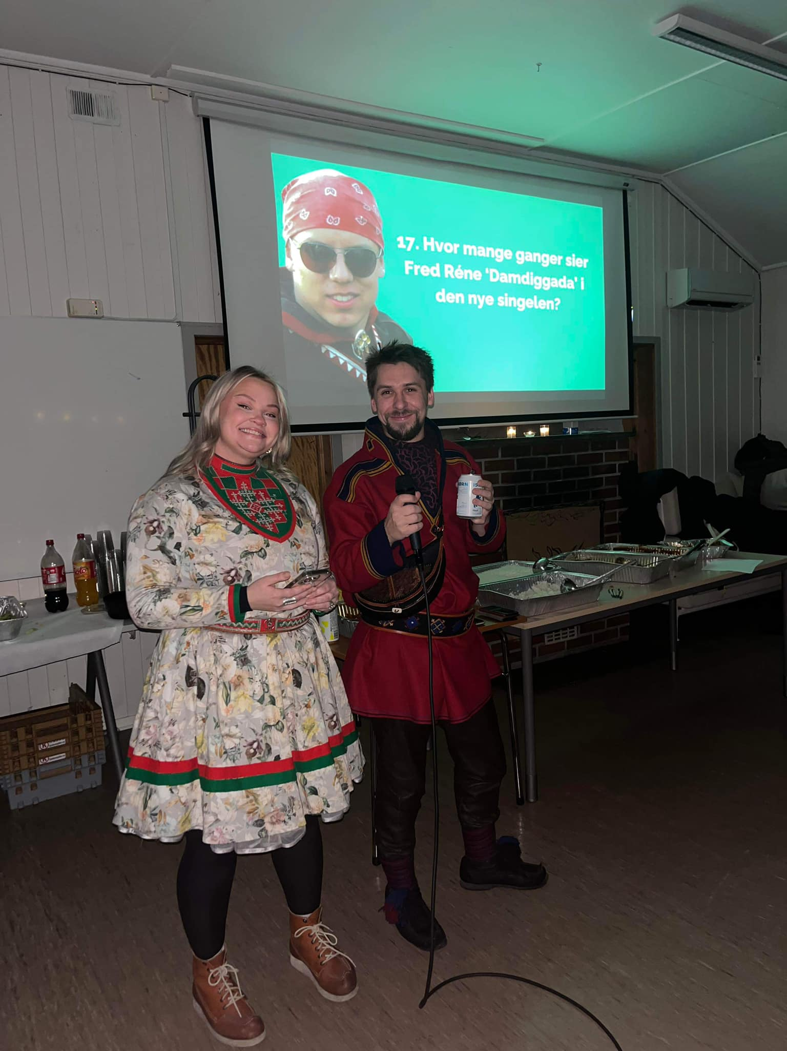
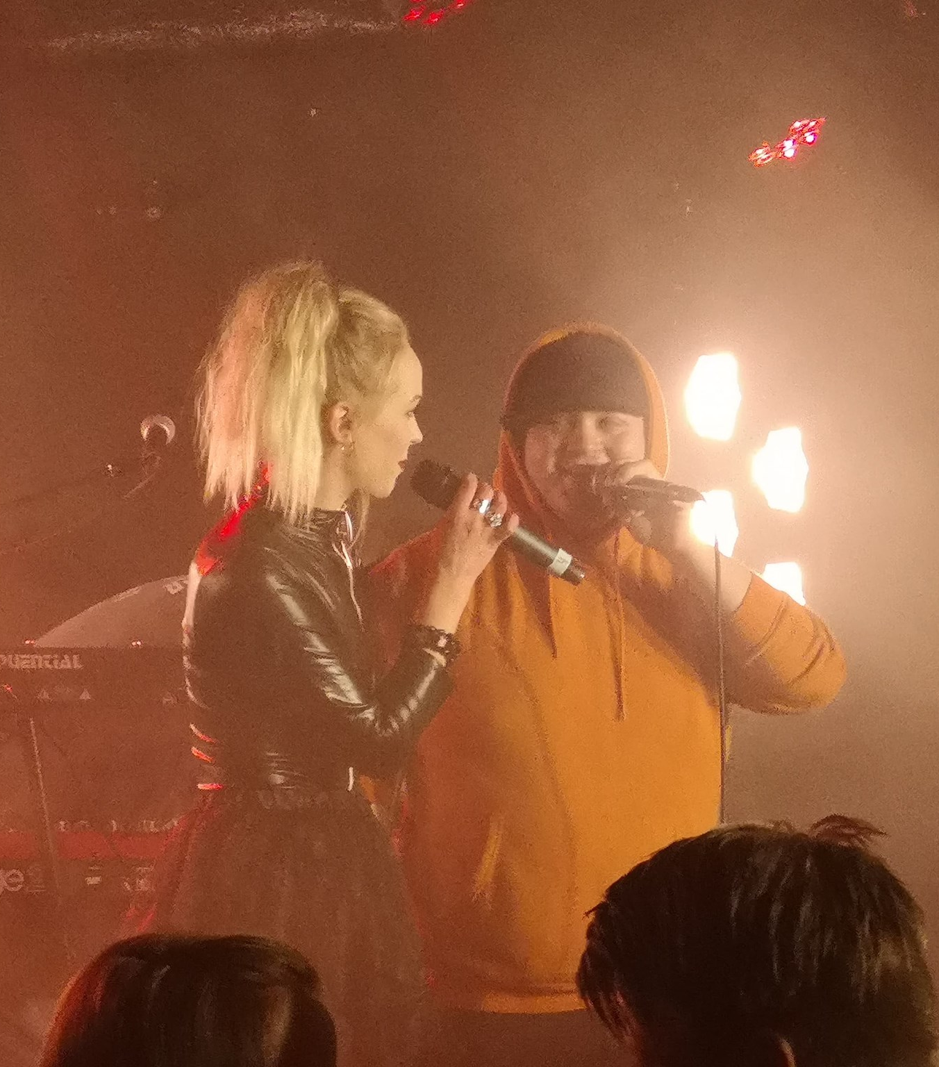
Lágideamit / Events
Beaivvášriemut Sunparty
Studeantavuolla Student-beer
Háŋout campusis Hangout on campus
Gažus Quiz
Konserattat Concerts

Slide 6
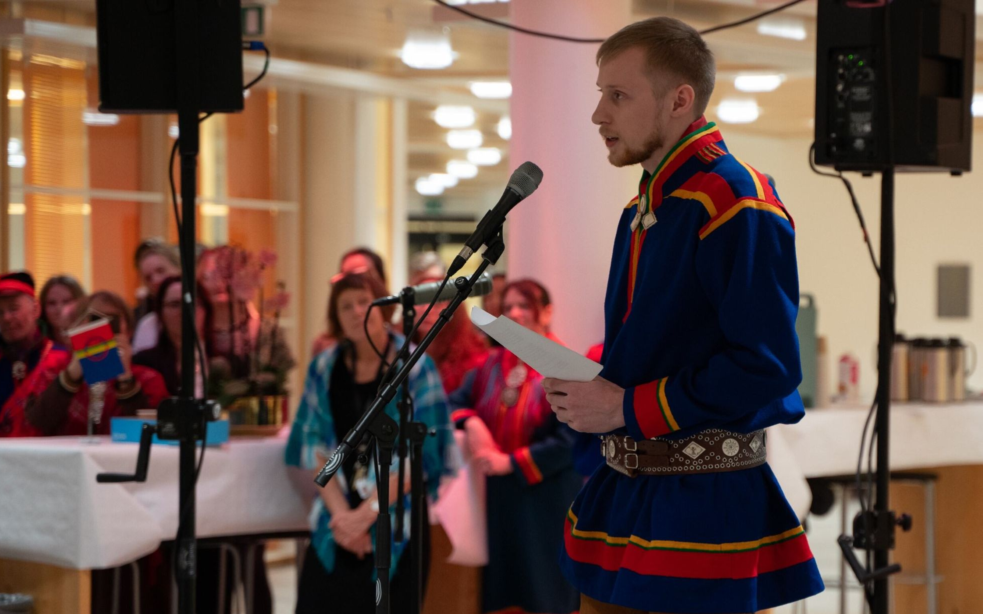
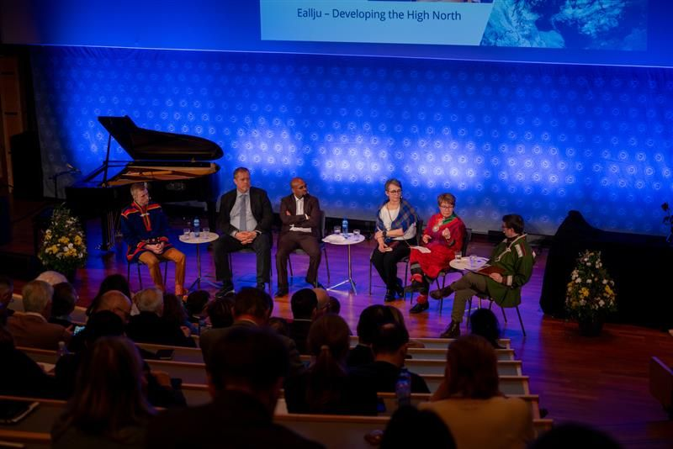
Iežá bargu / Other work
Stand
Panelságastallamat Panel talks
Sáhkavuorru sámi álbmotbeaivve Speech on the Sámi national day
Ovttasbargu universitehtain Cooperation with the university

Slide 7
Giitu mu ovddas!
Leatgo dis gažaldagat?

