Slide 1
Practice and Challenges of Social Work in Bangladesh
S.M. Monirul Hassan
Professor, Department of Sociology
University of Chittagong, Bangladesh

Slide 2
Draw a sketch about
Socio-Demographic Status of Bangladesh
1
Social Work Practices in Bangladesh
2
Social Work Challenges in Bangladesh

Slide 3
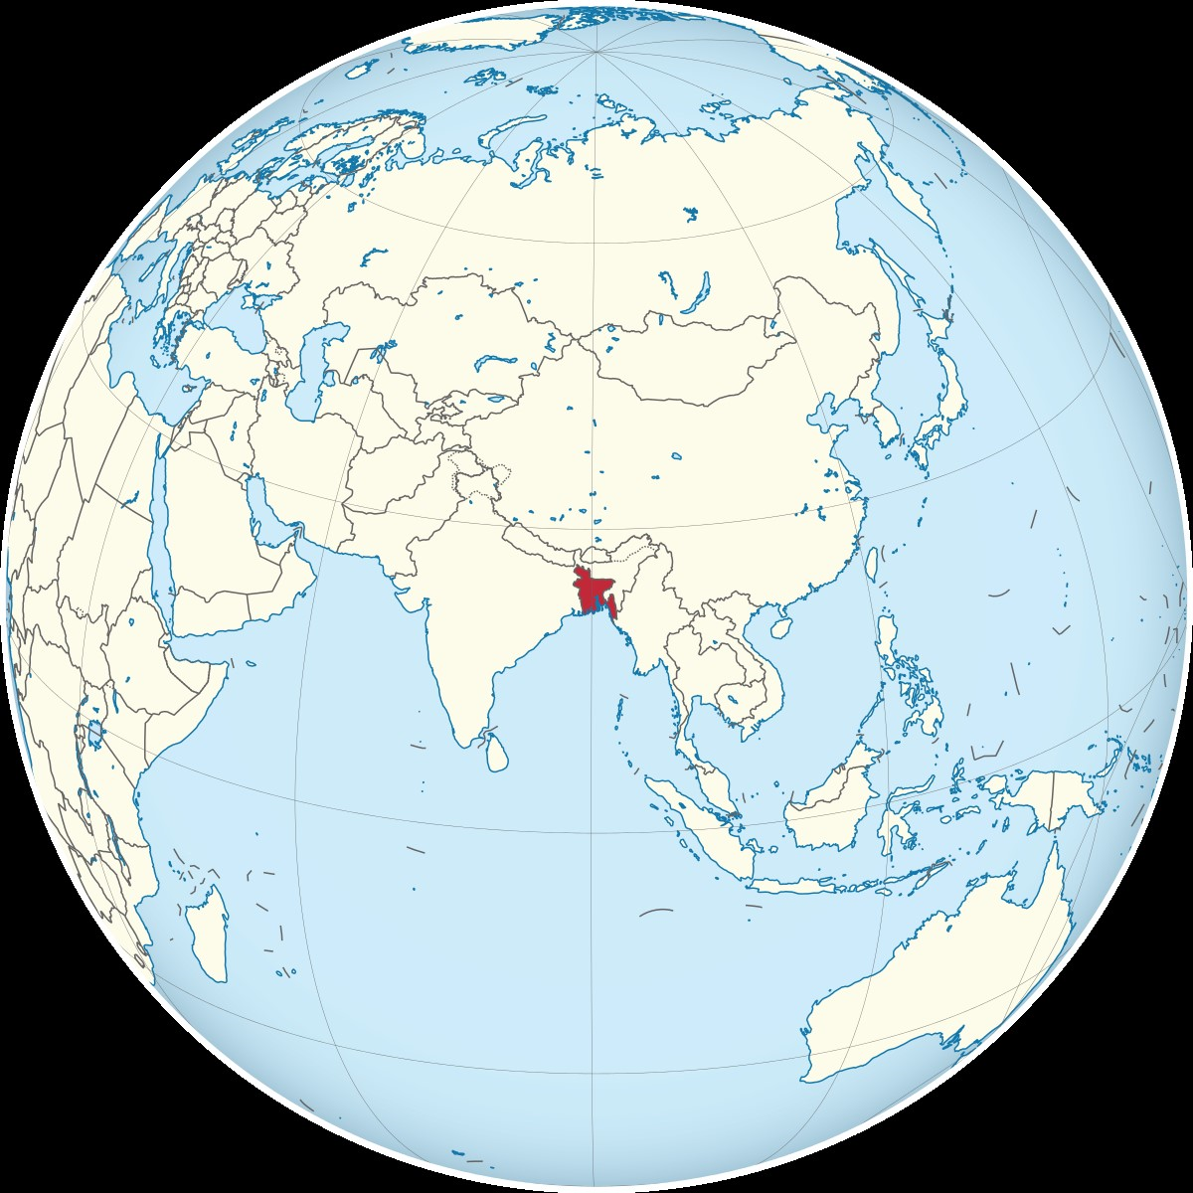
Bangladesh in World Map

Slide 4
Socio-Demographic Status of Bangladesh
Population: 169.82 Million (2022 Census)
GDP:420.52 billion
GDP per capita: 2,470 (nominal, 2023 est.)
GDP by sector: Agriculture: 11.66%
BBS:2023
Industry: 35.27%
Services: 53.07%
Labor Force: 70,961,067 (2021)
Female 31.1%
Male 68.9%
Population density
1,119 per square kilometer
Surrounded by India, Myanmar and Bay of Bengal
Average Household size: 4.00 per household
(BBS: 2022)
Area 56,977 sq. .miles/1,47,570 sq. kilometers
59.1% Household Head in old age group
Old age group has 61,30% male and 56.90 Female

Slide 5
Socio-economical Characteristics and Informal Social Work System in Bangladesh
High Population (Workforce playing a vital role as a Human Resource)
Low-Income Country (GDP growing)
Traditional society (Rapid or Fast response)

Slide 6
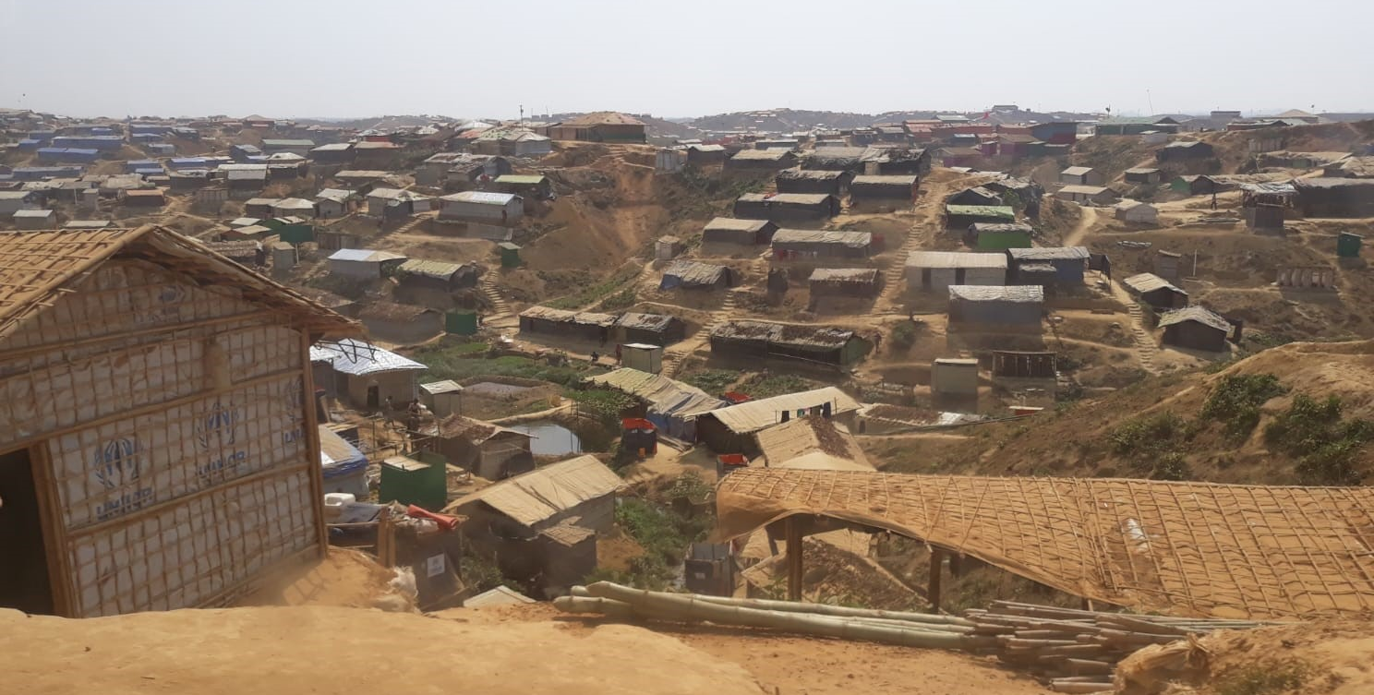
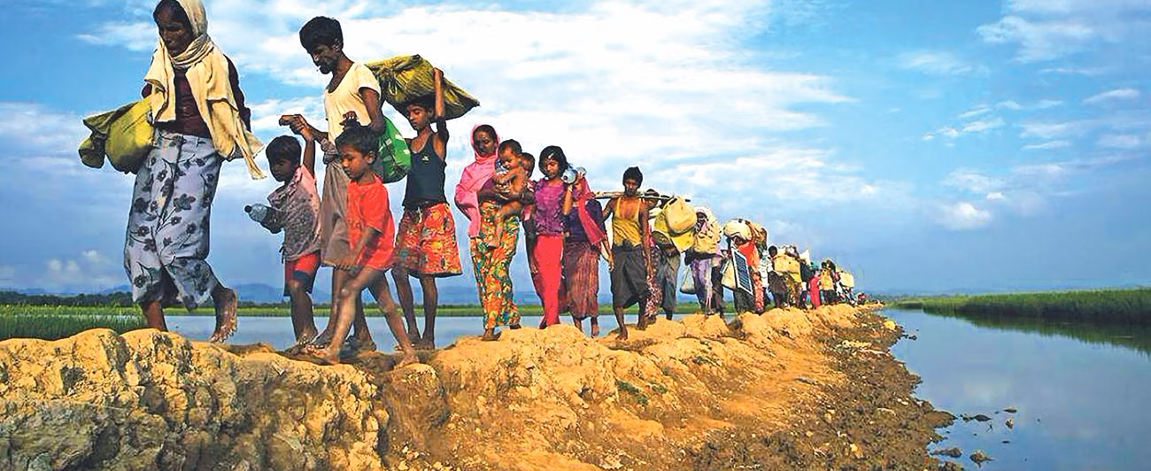
Diagram of Informal Social Work Practice: an example from Rohingya Crisis in Bangladesh
According to the United Nations High Commissioner for Refugees (UNHCR), the UN Refugee Agency, as of the end of March 2023 there were nearly 961,000 Rohingya refugees in Bangladesh.
Role of Bangladesh:
Informal care or support: Fast response from countryside people (Traditional society+ Human resource)
Social Capital: Individual contributions with money, cloth, food, shelter
Involvement of third sectors

Slide 7
Formal Social Work Practices in Bangladesh
Equitable socio-economic development
Social protection & Social Empowerment
Social justice and social inclusion
Women’s Advancement and Rights
Child Protection

Slide 8
Diagram of Formal Social Work Practice in Bangladesh
Social Work activities led by Social Welfare Ministry
Connection with other Government Institutions
It provided support to Vulnerable people.
Here vulnerable people means:
Old-age people
Widow, Deserted, and Destitute Women
Disable people
Orphan
Beggar/Homeless
Street Children
Transgender people
Ethnic Minority

Slide 9
Elucidation of formal social work practices in Bangladesh
Services | Expenses in 2020-21 (in million USD)
Old age allowance | 274.59
Allowances for the Widowed, Deserted and Destitute Women | 114.88
Disable People | 151.30
Transgender and Ethnic Minorities | 4.32
Secondary and Higher Secondary Education | 370.23
Homeless Housing Support | 201.46
Micro credit support | 15.31
Child Protection | 12.14
Disaster Management | 61.64
Primary Health | 1.17

Slide 10
Major Challenges of Social Work Practices in Bangladesh
Pre-dominant urban settings
Disaster vulnerabilities
Economical Crisis
Health Issues
Lack of Professional Social Work ethics

Slide 11
Thanks All for your kind Attention

