Slide 1
Linguistically Responsive Teaching as a A Cross-Cutting Theme in Teacher Education
Inker-Anni Linkola-Aikio & Pigga Keskitalo
ACCESS conference, University of Lapland
September 19, 2024

Slide 2
LINCOSY-project
Co-creating Linguistically Responsive Teaching in the Context of Endangered Sami Languages
2023 – 2027, University of Lapland, Research Council of Finland (Finnish Academy)
https://www.ulapland.fi/Saitit/Lincosy/Lincosy-in-English
RQ1: What kind of frames can be identified for teaching in endangered Sami languages in primary schools in Nordic countries?
RQ2: How is Sami languages teaching context perceived by pupils, parents,
teachers, school leaders and policymakers?
RQ3: How can Indigenous school research improve language teaching in
endangered languages in a linguistically responsive way?

Slide 3
Linquistically responsive teaching
linguistically responsive teaching (LRT) - language awareness
Lucas & Villegas (2011, 2013)
LRT relates in particular to the importance of teachers’ pedagogical actions when working with linguistically diverse learners (see, e.g., Alisaari & Heikkola, 2020)
Tool to analyse teachers’ attitudinal, cognitive, and motivational resources and their capabilities to facilitate and advance the learning of language learners (Repo 2023)
Scaffolding: Modelling, Bridging, Contextualisation, Building schema, Re-presenting tex, Developing metacognition

Slide 4
Indigenous linguistically (and culturally) responsive teaching
classroom teaching should authenticate and support students’ cultural and linguistic backgrounds and behaviors (Hollie & al. 2022)
teachers can engage with the cultural foundations of socialemotional wellbeing. A holistic approach, where the child is placed at the centre alongside family, spiritual, physical, and emotional elements (Denston et al 2022)
a) holistic learning; (b) spirituality, culture, and language; (c) learning from nature and from elders; (d)storytelling as a pedagogical tool; (e) encouraging critical thinking (f) learning about intergenerational trauma on students; (g) ensuring tribal justice and Indigenous sovereignty (Ganesan)
Relationality, community, speach community, narratives, storytelling, wellbeing

Slide 5
LINCOSY 2023 - 2027
Autumn 2023​
Planning, research ethical evaluation, contacting the schools
year 2024​
data collecting​ (schools, teachers, school leaders, parents, pupils, policy makers) Map the situation (observations, interviews, survey)
year 2025​
data collecting, teaching innovations, co-creating​, workshops (diary)
year 2026​
international visits
year 2027​
dissemination (several languages, giving back)​
Data by now: Teachers’ interviews and observations
10 teachers, 2 countries

Slide 6
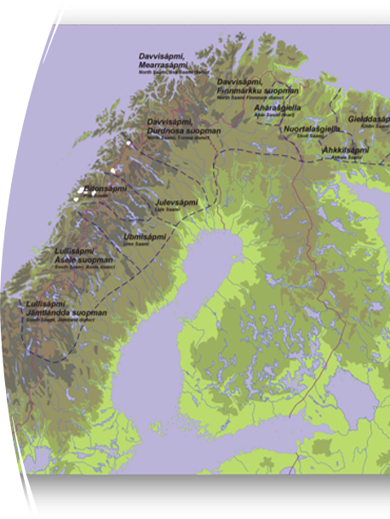
Sami language teaching context
Several Sami languages (also in one school)
Endangered languages (UNESCO)
Assimilation, language change, revitalisation
Multilingualism
Position of the Sami languages (in the school, in the community, municipality, in the country)
Community support
Legislative support, different countries
Curricula support
Diverse linguistic backgrounds (pupils, parents, teachers)
Teacher, parent, pupil, policy maker, school leaders, community expectations

Slide 7
Multilingualism: The presence of several Sámi languages, even within the same school. Several other languages
Position of Sámi Languages: The status of Sámi languages within schools, communities, municipalities, and countries.
Community Support: The level of support from local communities for Sámi language use. Level of revitalisation
Legislative Support: Differences in legal frameworks across nation states that impact Sámi language preservation.
Curriculum Support: The extent to which Sámi languages are integrated into school curricula.
Diverse Linguistic Backgrounds: The varying linguistic backgrounds of students, parents, and teachers in the schools.
KEY RESULTS
Navigating Ambivalences In Linguistically Responsive Teaching

Slide 8
Implications for teacher education
[Culturally] and linguistically responsive teaching (attitudinal, cognitive, and motivational resources and their capabilities to facilitate and advance the learning of language learners (Repo 2023); scaffolding
Intercultural education (dialogue and cooperation between diverse cultural and linguistic perspectives, collaboration between communities, educators and policymakers, bridge the gap between traditional and formal education systems, flexible, responsive and inclusive)
Continuing education (Decrease ambivalences between Indigenous language educators and frameworks and practices that affect teaching; support teachers) (multilingualism, multiculturalism)
Collaboration between communities, educators, and policymakers; equitable distribution of power

Slide 9
Thank you!
https://www.ulapland.fi/Saitit/Lincosy/Lincosy-in-English
inker-anni.linkola-aikio@ulapland.fi
pigga.keskitalo@ulapland.fi

